Slide 1


Jacobian Matrix of a Manipulator
Jacobian matrix of a manipulator maps joint speeds to Cartesian velocity of the end-effecter (EE).
Mathematically,
………….(1)
For the 3-DOF articulated manipulator shown aside,
3x1 3x3 3x1
Since it is 3-DOF, the EE will have 3 DOFs; so V_{e}(t) will be of 3x1; since there are three joints will be
an array of 3x1; hence j(q) will be 3x3.
Picture taken from Robotics and Control by Nagrath and Mittal

Slide 2
Functions of Jacobian Matrix:
it helps to determine the end-effecter velocity if we know the joint speeds
it helps to determine the joint speeds to get a desired end-effecter speed. For example, in robotic
welding operation we know the desired EE speed. With the help of the Jacobian matrix we can determine the joints speeds to get the desired EE speed.
Determinant of the Jacobian matrix is also an indicator of the health/condition of the manipulator at any configuration. If the determinant value is high, then the condition of the manipulator is good to carry out task; but if the determinant is close to zero we call that configuration as ill-conditioned. Such ill-conditioning happens at the boundary of the workspace.
Determination of singularity. At any point if the determinant of the Jacobian matrix becomes zero, that point is called singularity point.

Slide 3

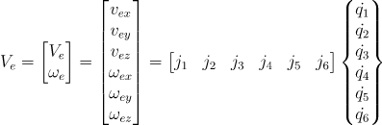
For 3-DOF manipulator, ………….(2)
3x1 [3x1 3x1 3x1] 3x1
3x3
So for a 3-DOF manipulator, Jacobian matrix consists of 3 columns where each column is a contribution
of the corresponding joint towards the end-effecter velocity. For example, j₁ is the contribution of the
first joint towards the EE velocity. Similarly, j₂ is the contribution of the 2nd joint towards the EE velocity.
So for a 6-DOF manipulator,
Each j_{i} is 6x1 element.
6X6
6x1 6x1

Slide 4
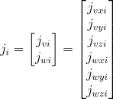
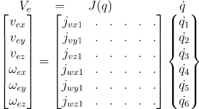
. In other words, for a 6-DOF manipulator
6x1 6x6 6x1

